Slide 1

Anomaly detection in vessel traffic
A SAAB production

Slide 2


NDA’s
Signed!
Now waiting for a response from HR to finally get access to the data.

Slide 3


Last week
Continue Literature Review Document
Try to understand Recurrent Neural Networks and LSTM

Slide 4




What we think RNN’s are
Inputs
Hidden layers – perceptrons - math
Outputs
And some vodoo magic.

Slide 5
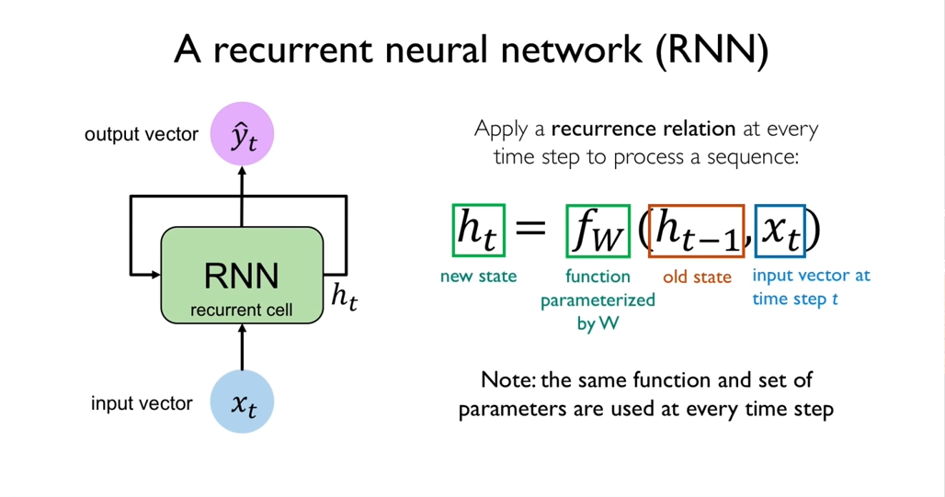
Example

Slide 6



This week
Design a Recurrent Neural Network
Data exploration – real data
Finish Literature review

